Slide 1
Interactive Coffee Chain Sales Dashboard
Internship Project Summary
-By Jasdeep Kaur

Slide 2
So, I decided to create an interactive business intelligence dashboard for a coffee chain dataset. The purpose was to transform raw sales data into visual, actionable insights for easier decision-making.
Objective: Design an interactive dashboard for business stakeholders.

Slide 3
Tool and Techniques
Power BI Desktop for dashboard creation.
DAX Measures for custom calculations and KPIs.
Custom Slicers for date, product, and region filters.
Interactive Maps for geographical insights.
Data cleaning & transformation using Power Query Editor.

Slide 4
Dashboard Features
a. I used a KPI visual for target_profit and actual_profit.
b. I used slicers for State, Product, Date(Year, Month, Day) for interactivity.
c. I did a time-series analysis with a “line and clustered column chart.”
d. I added cards for “Total Profit”, “States”, “Units Sold” and “Total Sales.”
e. The Colors were specifically chosen by me and took a bit of my time.
f. I created a navigation menu by creating Buttons for “Page Navigation.”
g. It includes 4 pages as follows:
Summary Page: Overview of profit, sales, units sold, and state performance. Performance Analysis: Actual vs Target comparisons for KPIs. Sales & Profit Breakdown: Analysis by product type, category, and month. Geographical View: Regional sales and market trends.
(Images on next 4 slides.)

Slide 5
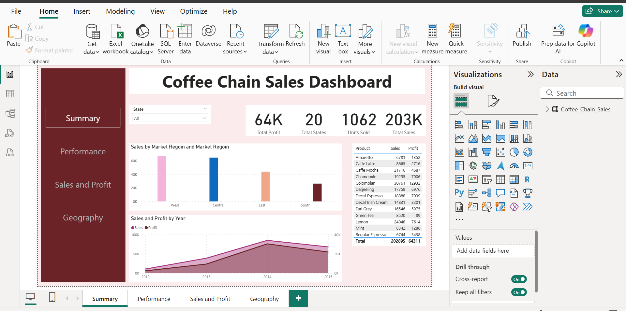

Slide 6
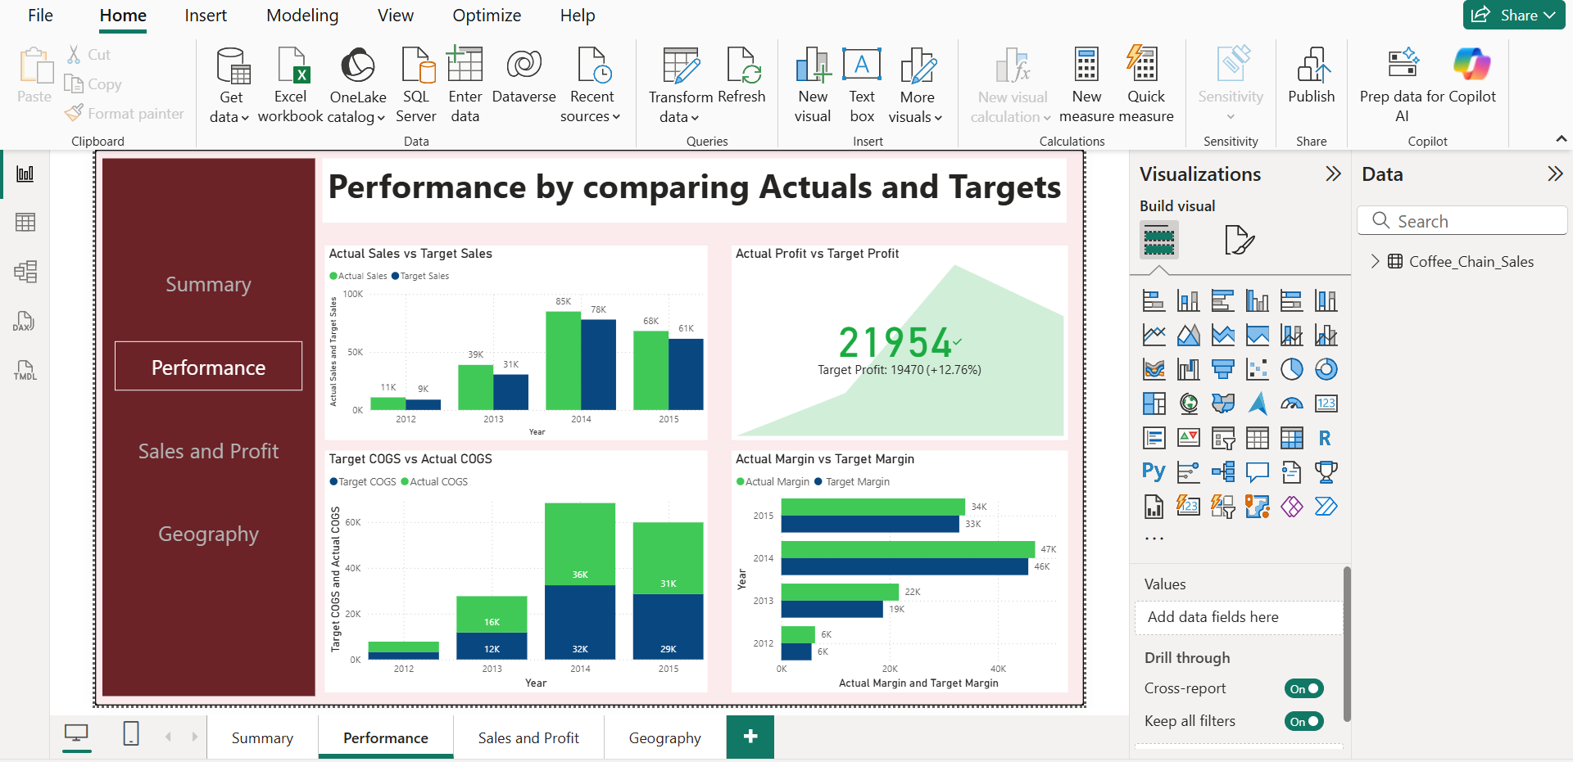

Slide 7
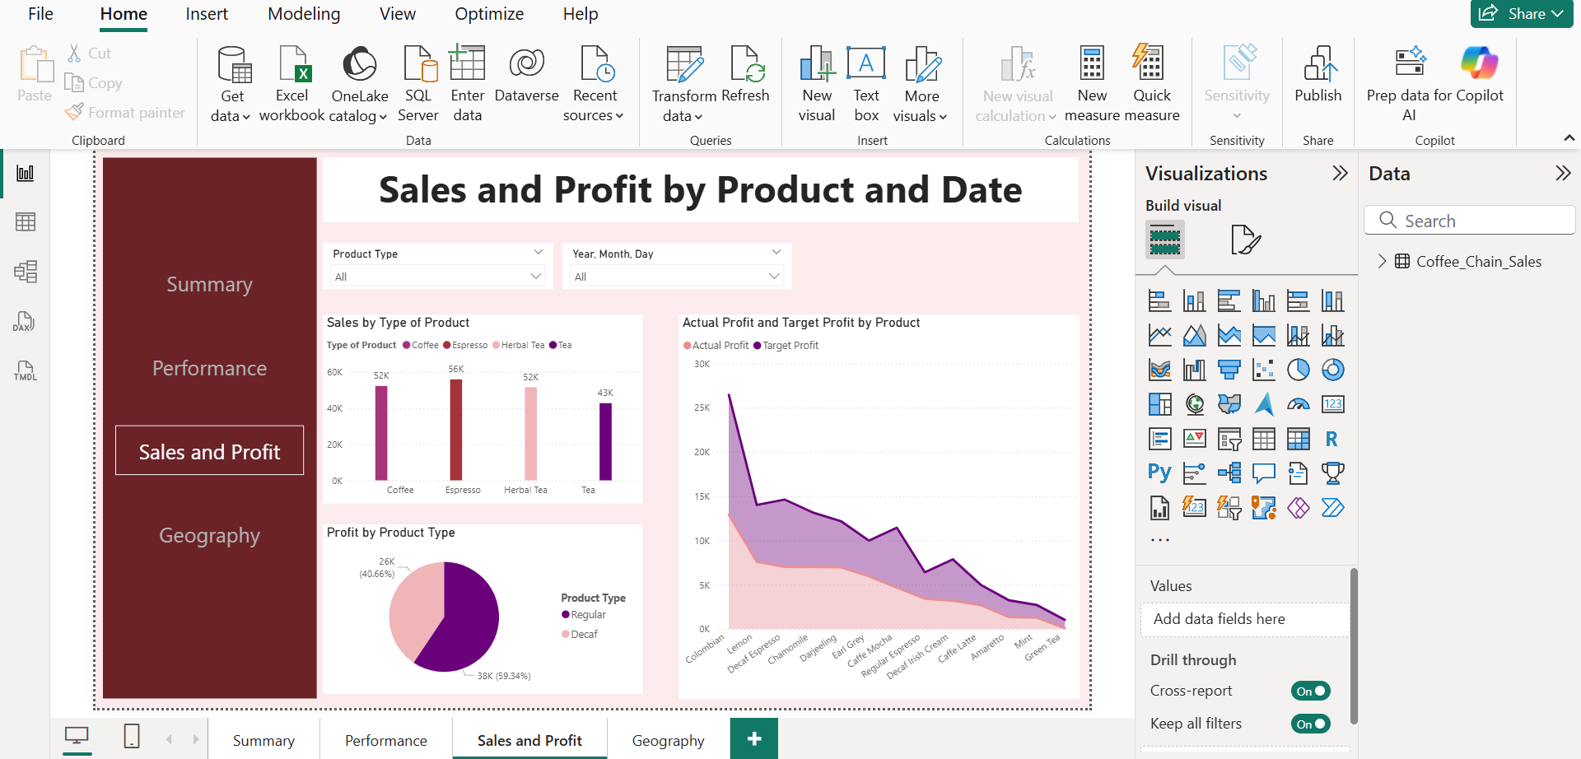

Slide 8
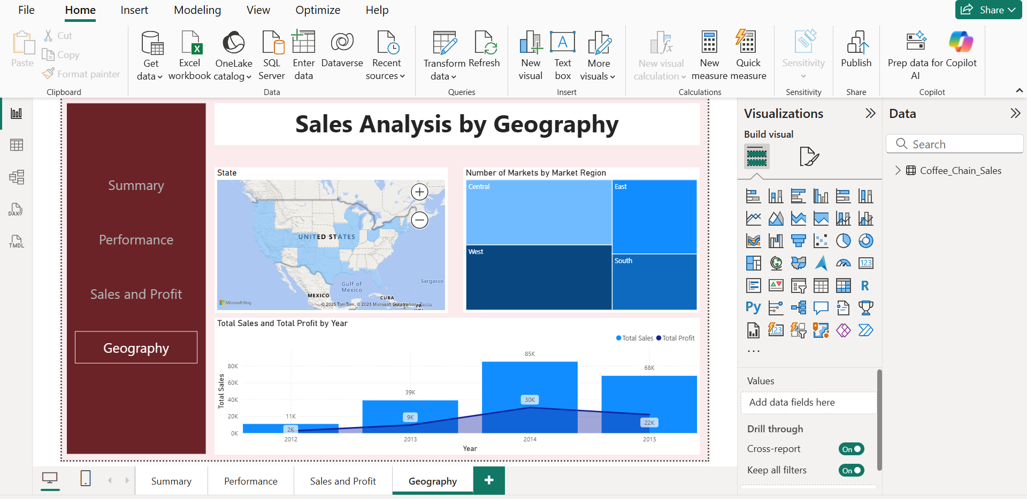

Slide 9
Key Insights and Challenges
Insights:
The highest sales were recorded in East Region in 2014.
Columbian Coffee contributed the largest share of profit.
Seasonal trends indicate peak sales during July, August, September, October i.e. around Fall Season.
Profit margins vary significantly by region and product type.
Challenges:
Handling inconsistent data formats.
Choosing which data columns to show against which data columns.
Creating accurate measures for KPI tracking.
Designing a layout that balances detail with clarity.

Slide 10
Thank you !!

